Slide 1





Trilochan Tripathy
Consumer Goods Insights
Tool Used:-

Slide 2

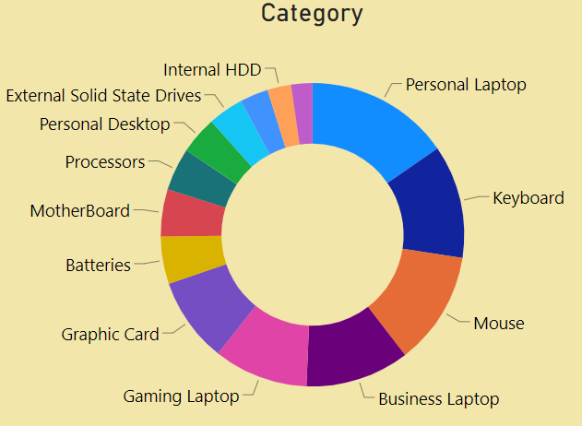
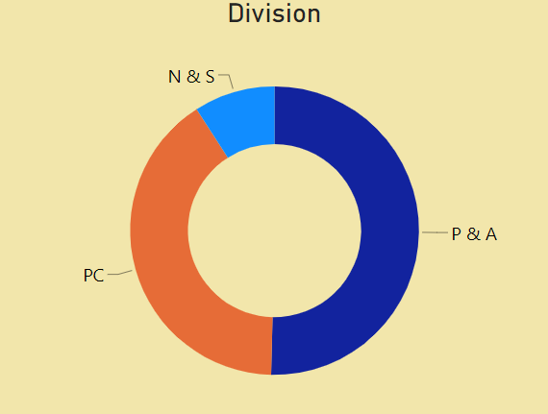
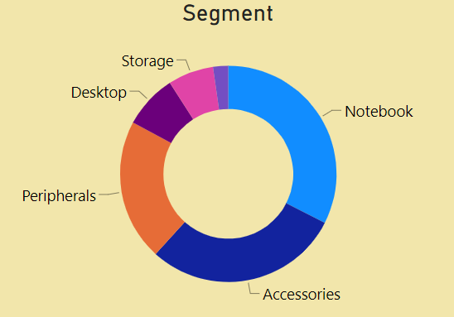
Introduction:-
About Company: Atliq Hardware is a prominent computer hardware producer based in India, holding a leading position not only in the Indian market but also in various other countries.
Trilochan Tripathy

Slide 3

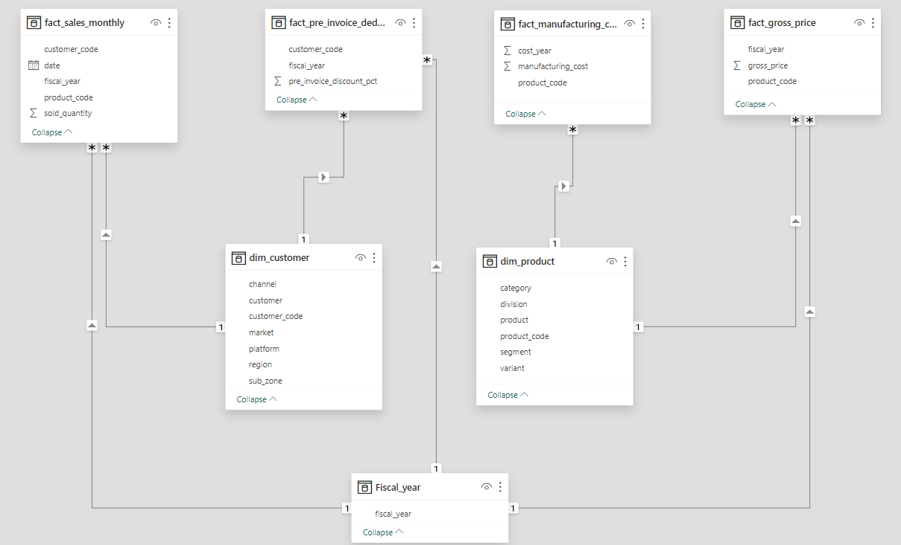
Data Model:-
Trilochan Tripathy

Slide 4
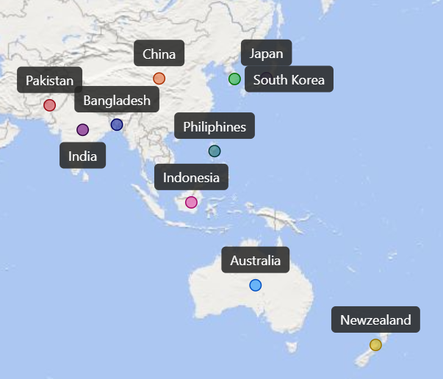
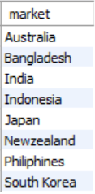
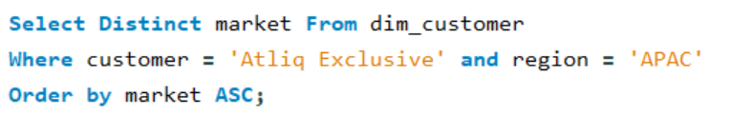
- Provide the list of markets in which customer "Atliq Exclusive" operates its business in the APAC region.
Insights
Atliq Hardware operates in a total of 27 countries.
Out of 27 markets, a customer named ‘Atliq Exclusive’ operates in 10 countries in the region of APAC.
Trilochan Tripathy

Slide 5

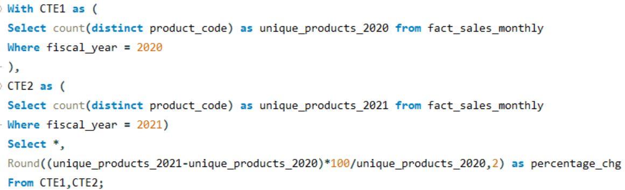
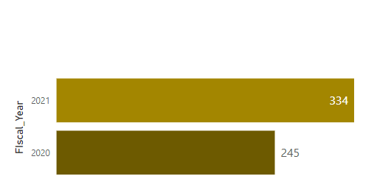

-- What is the percentage of unique product increase in 2021 vs. 2020?
Unique Product Growth
2020 vs 2021
Insights
Unique product sales experienced a spike of 36% in 2021 as compared to the previous year.
Total unique products recorded in the Year 2020 was 245.
Total unique products recorded in the Year 2021 was 334.
Trilochan Tripathy

Slide 6
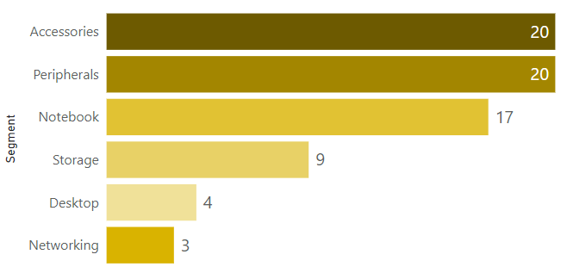
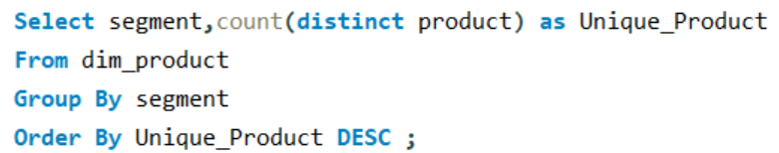
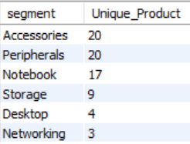
-- Provide a report with all the unique product counts for each segment and sort them in descending order of product counts.
Unique Product By Segment
Insights
Out of 6 segments, Accessories and Peripherals are selling 20 unique products followed by Notebook, Storage, Desktop, and Networking.
Trilochan Tripathy

Slide 7
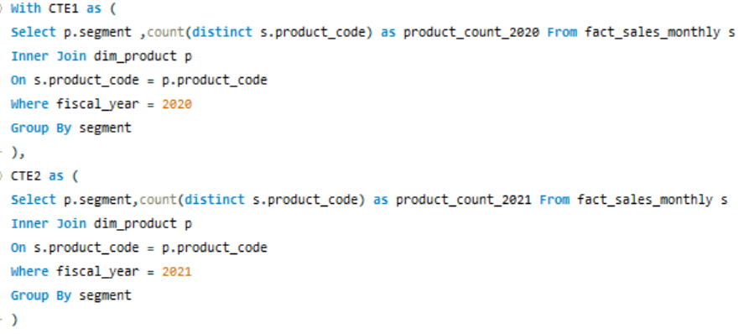

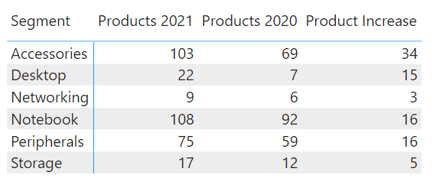
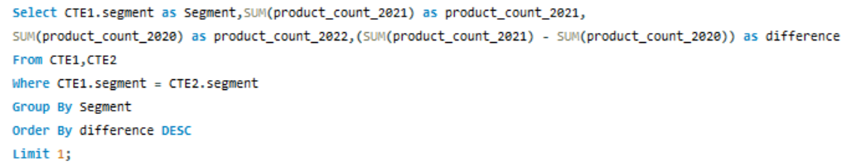
-- Which segment had the most increase in unique products in 2021 vs 2020?
Segment Wise Unique Products
Trilochan Tripathy

Slide 8
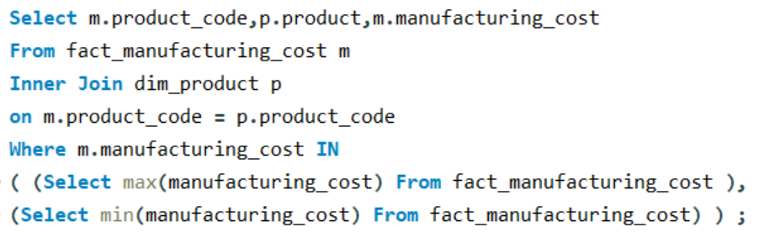
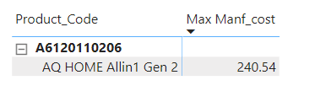


-- Get the products that have the highest and lowest manufacturing costs.
Max/Min Manufacturing Cost By Product Code
Insights
Among all the products, the manufacturing cost of “Home Gen 2” is the highest ($240.53) whereas “Master Wired Ms” has the lowest manufacturing cost ($0.892).
Trilochan Tripathy

Slide 9
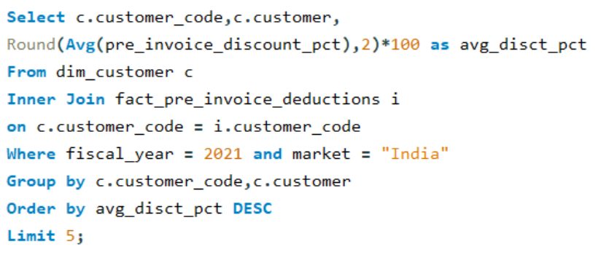
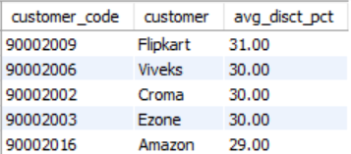
-- Generate a report that contains the top 5 customers who received an average high pre_invoice_discount_pct for the fiscal year 2021 and in the Indian market.
Top 5 Customers
Insights
During the fiscal year 2021, Flipkart, Viveks, Croma, Ezone, and Amazon are the top 5 customers who received the highest pre-discount percentage.
Flipkart made the highest discount with 31%.
Trilochan Tripathy

Slide 10
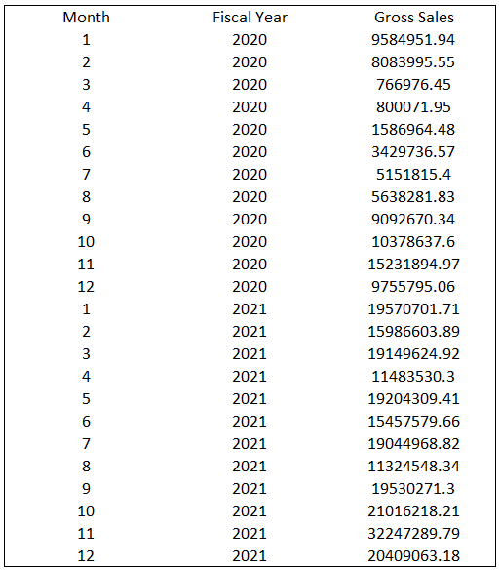
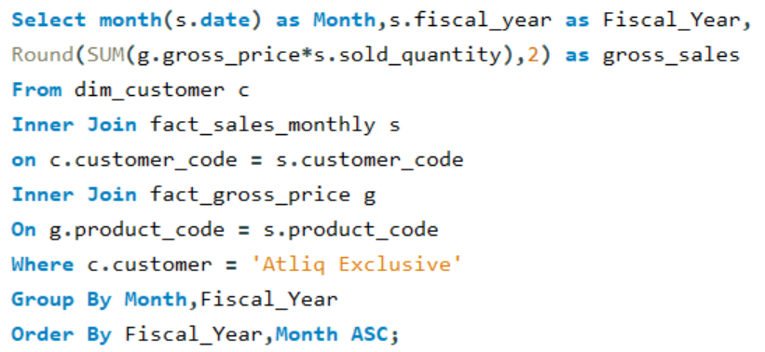
-- Get the complete report of the Gross sales amount for the customer “Atliq Exclusive” for each month.
Insights
During the fiscal year 2021, Flipkart, Viveks, Croma, Ezone, and Amazon are the top 5 customers who received the highest pre-discount percentage.
Flipkart made the highest discount with 31%.
Trilochan Tripathy

Slide 11
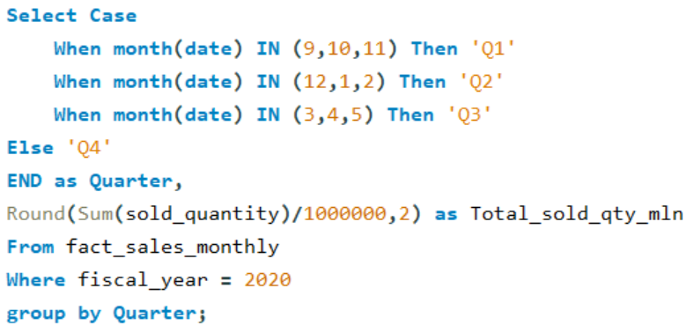
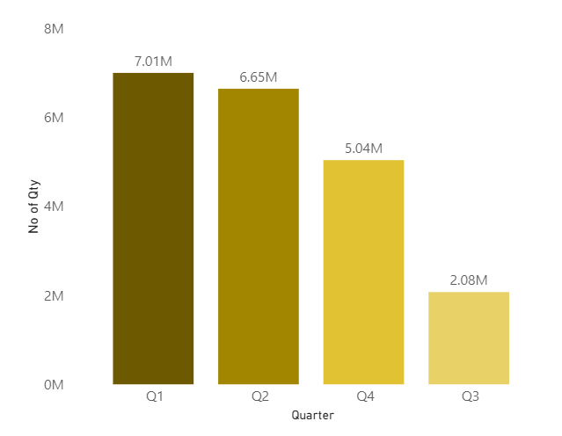
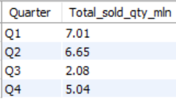
In which quarter of 2020, got the maximum total_sold_quantity?
FY 2020 – Quarter Wise Distribution
Insights
During the first quarter of fiscal year 2020, Atliq Hardware sold the most number of quantities (Over 7 Million).
Atliq Hardware saw a decrease in sold quantities in Q2 and Q3, but increased to 5.04 million in Q4.
Trilochan Tripathy

